Slide 1


Capstone Project –Battle of Neighborhoods
New York city borough with most property sales and exploring the neighborhood for common venues

Slide 2

Introduction/business problem
New York City has diverse culture and point of interests uniquely spread across 5 boroughs and its distinct neighborhoods make the city so special
A research team wants to analyze New York city properties sale data and visualize the sale activities for each of its 5 boroughs. They have a requirement to find out the “Borough” that made the most sales.
The team would identify the borough with most sales based on sale data, then would utilize the Foursquare APIs/location data to identify the recommendations for common/popular venues in the neighborhoods. Using K means, the common venues will be clustered in groups Finally this data will be projected and visualized on a city neighborhood map

Slide 3

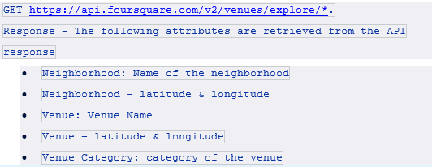
Data selection
Find out the borough that had the most sales in the NY property sales data set from Kaggle
https://www.kaggle.com/new-york-city/nyc-property-sales/data
We then use the NY geospatial data to merge the neighborhood coordinates and make use of Foursquare APIs to get the top recommendations for these neighborhoods. https://geo.nyu.edu/catalog/nyu_2451_34572

Slide 4

methodology
A statistical exploration methodology was used to analyze the problem and datasets along with visualization techniques.
Neighborhood locations are converted into respective latitude and longitude coordinates.
This data analysis and exploration also involved a main machine learning technique using which the data was clustered i.e. most popular neighborhood venues. K-means clustering implemented in Python to produce the results.
Foursquare APIs are leveraged to get the top recommended venues for each of the neighborhoods.

Slide 5
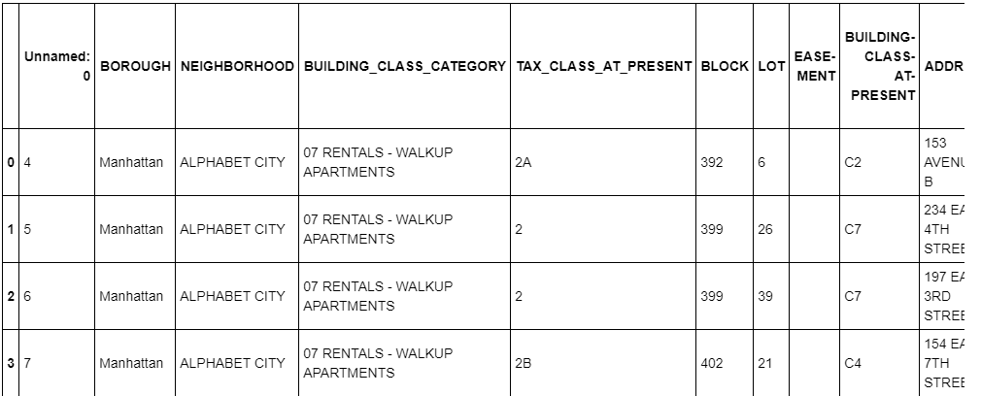
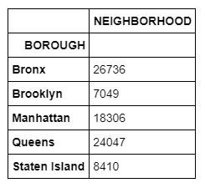
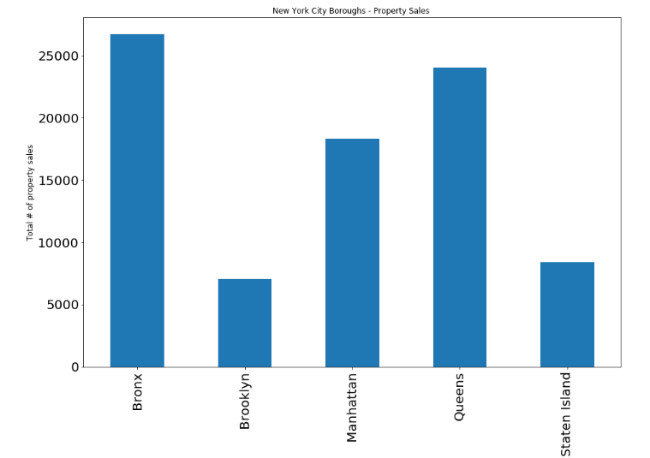
methodology
Find out the borough that had the most sales in the NY property sales data set

Slide 6
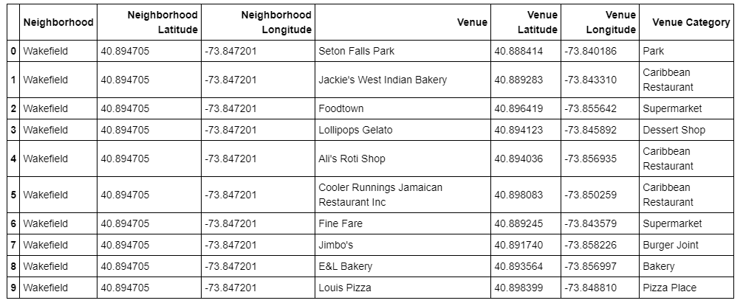
methodology
Using Foursquare APIs get the venue recommendations for each of the neighborhoods in the borough.

Slide 7
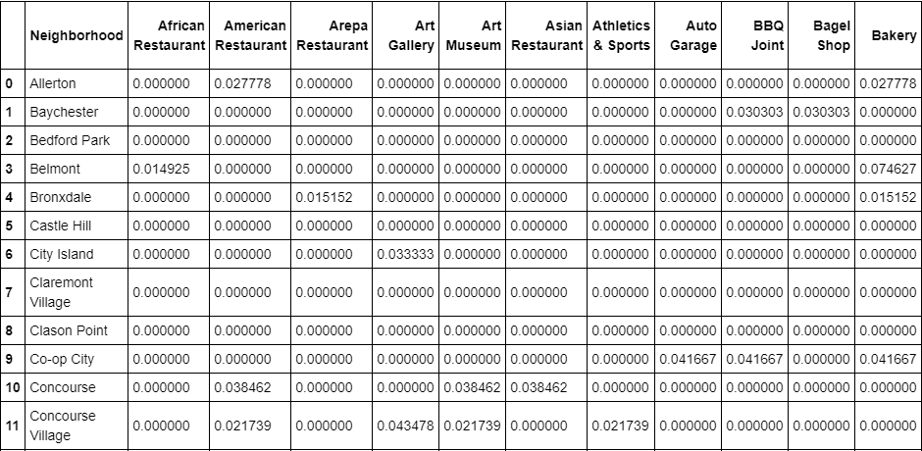
methodology
Group the venues using clustering and list the most common venues for each of the neighborhoods.

Slide 8

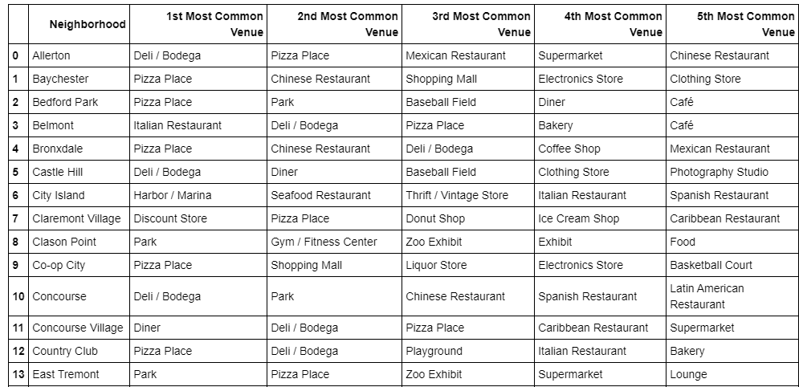
Results
k-means clustering used to segment/group top venues using neighborhood data.

Slide 9
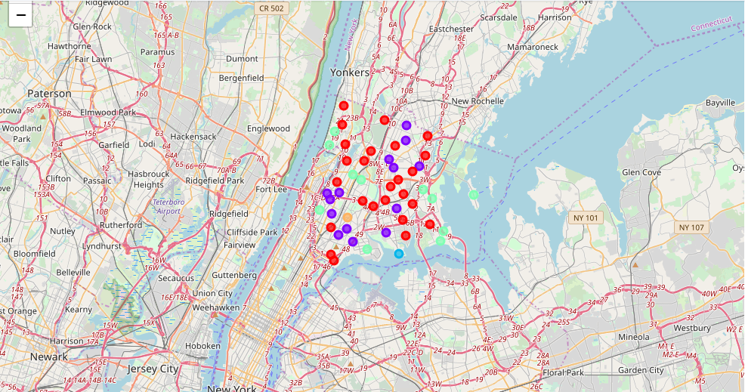
Results
Folium library used to visualize Bronx neighborhoods and its most common venue clusters.

Slide 10

Discussion
The NY property data set includes many sales with a nonsensical $0 amount. These sales are transfer of deeds between family members.
Using an optimal cluster value derived using elbow method would produce more accurate clustering results.

Slide 11
Conclusion
The purpose of this project was to determine the borough that had most sales in a year based on the NY city Kaggle data set. Bronx was identified as the top borough. We also wanted to explore the neighborhood around Bronx and get recommendations/top picks for the most common venues.
We were able to figure out the most common venues and cluster them using k-means. Finally, we visualized these findings in a NY location map and project these venues

